Slide 1




Algebra Factorising Expressions
$$3ab$$
$$2x+3y$$
$$\frac{5xy}{6}$$
Name :
Class :
Term 4 Semester 2
$$y=2x+1$$

Slide 2
Contents
Glossary
Page
Date
Description
2
3

Slide 3
Tasks
24
7
30
Essential Question
Questions
Notes
Summary
4
7

Slide 4
24
7
30
Date
Factorising Expressions
EQ – How do I factorise expressions?

Slide 5
24
7
30
Date
Factorising Expressions
EQ – How do I factorise expressions?
What is factorising?
If expanding brackets is turning 2(a + 3) into 2a + 6,
Then factorising is turning 2a + 6 back into 2(a + 3)

Slide 6
24
7
30
Date
Factorising Expressions
EQ – How do I factorise expressions?
What is factorising?
If expanding brackets is turning 2(a + 3) into 2a + 6,
Then factorising is turning 2a + 6 back into 2(a + 3)
How do we use the HCF to help factorise?
HCF – Highest Common Factor
The HCF of both terms is placed outside the front of the brackets.
If both terms have the same letter, that letter can be placed out
the front too.
Example: The HCF for 2a + 6 is ‘2’ so that is put out the front of
brackets like so…
2 ( ____ + _____ )

Slide 7
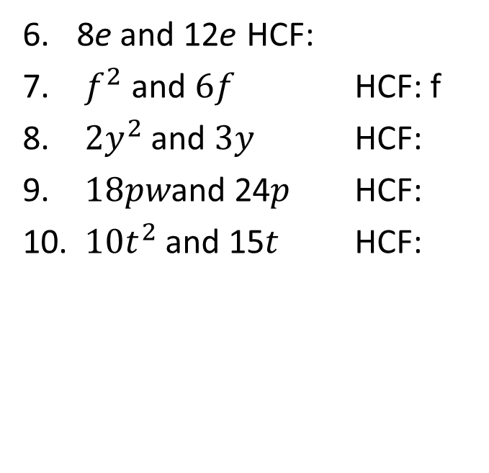
Task
Find the Highest Common Factor of the following?
Think: Which times tables are both terms in?
Remember: Letters can go out the front if they are in both terms
4 and 6 HCF: 2
10 and 15 HCF:
2a and 6 HCF:
21a and 28b HCF:
5. 3k and 6k HCF: 3k
8e and 12e HCF:
$f^{2}$ and $6f$ HCF: f
${2y}^{2}$ and $3y$ HCF:
$18pw$and 24$p$ HCF:
$10t^{2}$and 15$t$ HCF:

Slide 8
24
7
30
Date
Factorising Expressions
EQ – How do I factorise expressions?
What is factorising?
If expanding brackets is turning 2(a + 3) into 2a + 6,
Then factorising is turning 2a + 6 back into 2(a + 3)
How do we use the HCF to help factorise?
HCF – Highest Common Factor
The HCF of both terms is placed outside the front of the brackets.
If both terms have the same letter, that letter can be placed out
the front too.
Example: The HCF for 2a + 6 is ‘2’ so that is put out the front of
brackets like so…
2 ( ____ + _____ )
What goes inside the brackets?
From our knowledge of the Distributive Law, we know
2 ( ____ + _____ ) = 2a + 6
This means 2 x ______ = 2a and 2 x ______ = 6
So 2a + 6 is factorisied to produce
2 (__a__ + __3__)

Slide 9
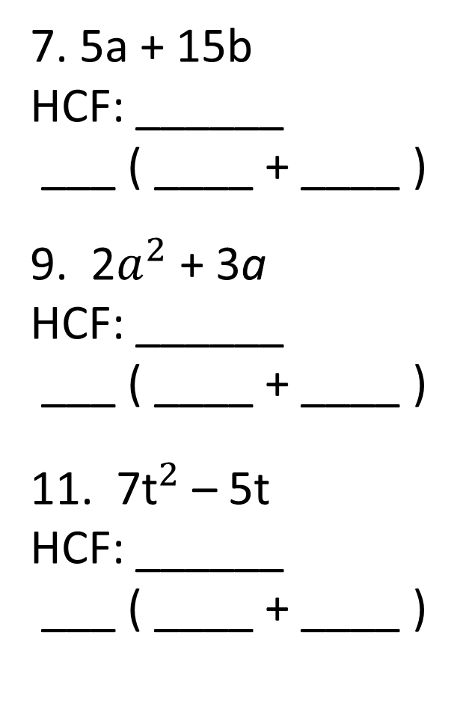
Dwyer Pg 41- 3.11 (All the odd questions)
2x + 6
HCF: ______
___ ( ____ + ____ )
3. 2c + 4
HCF: ______
___ ( ____ + ____ )
5. 3a – 6
HCF: ______
___ ( ____ + ____ )
7. 5a + 15b
HCF: ______
___ ( ____ + ____ )
9. 2$a^{2}$ + 3a
HCF: ______
___ ( ____ + ____ )
11. 7${\text{t}}^{2}$ – 5t
HCF: ______
___ ( ____ + ____ )

Slide 10


Task- Fill in the blanks
Remember!
Expanding Factorising
6 (a + 8) 6a + 48
= 6 x a + 6 x 8 HCF: 6
= 6a + 48 6 x ___ = 6a & 6 x ___ = 48
= 6 ( a + 8 )

Slide 11
Notes Review
24, 7 ,30
Date
Title
Essential question
Notes complete
Notes complete with colour and diagrams
Questions completed
Contents page filled in
Formula page filled in

Slide 12
Homework
Review your notes and write a summary answering the essential question.

